Slide 1

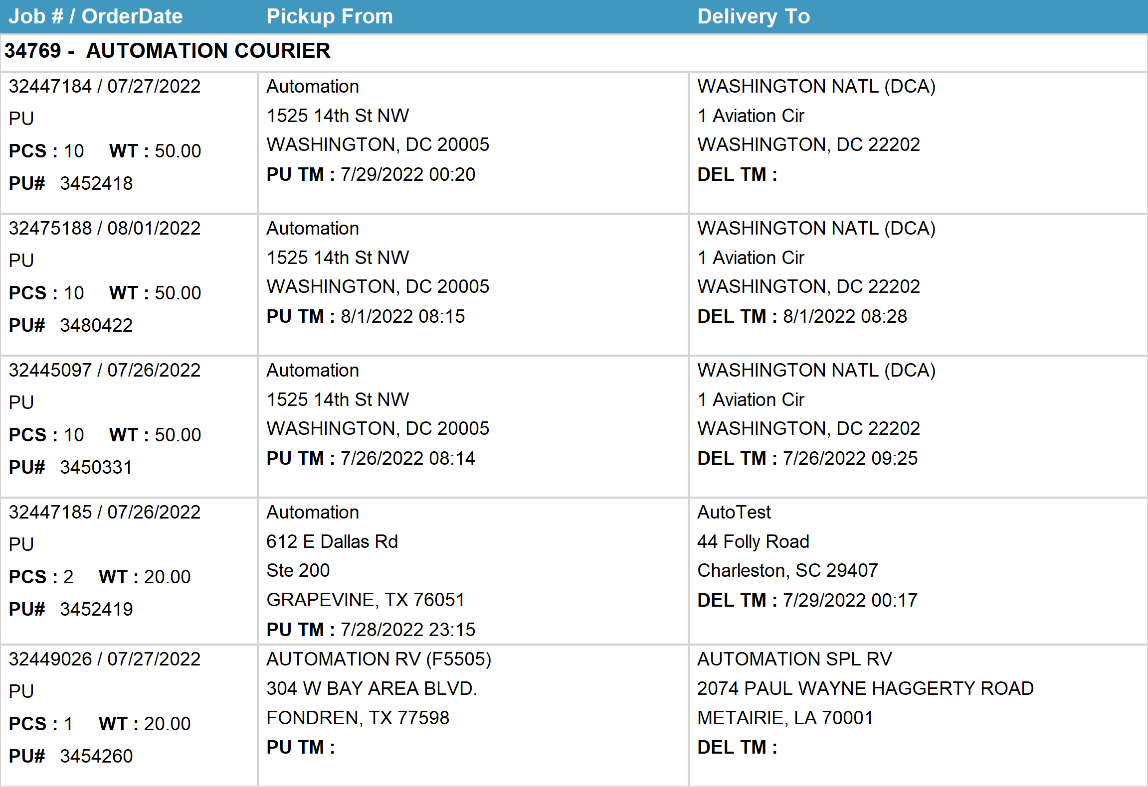
Agent Activity Report
*Data provided should be considered CONFIDENTIAL and PROPRIETARY*
©2011-2022 MNX Global Logistics. All rights reserved.
8/2/2022 12:50 AM
Print User : automation

Slide 2
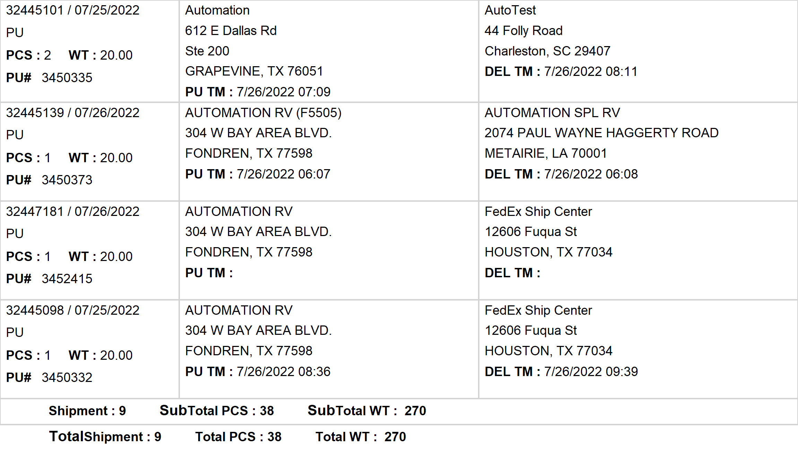
Agent Activity Report
*Data provided should be considered CONFIDENTIAL and PROPRIETARY*
©2011-2022 MNX Global Logistics. All rights reserved.
8/2/2022 12:50 AM
Print User : automation

